Slide 1
Oracle Application Express (APEX)
Project Implementation for
COSC 5050 Distributed Database Applications
Lab5

Slide 2
APEX Forms with Procedure
Use of procedures
Insert
Form on procedure
Update
Form on procedure
Fetch record
Database fields definition
Delete
Button for process
Process on PL/SQL

Slide 3
Use of Procedure
Use of procedure for insert, update, and delete
Three stored procedures
ADD_HT_EMP
UPD_HT_EMP
DEL_HT_EMP
We will create form page on a procedure
Notes:
--drop procedure add_ht_emp;
--drop procedure upd_ht_emp;
--drop procedure del_ht_emp;
create or replace procedure ADD_HT_EMP
( EMP_FIRST_NAME_IN in VARCHAR2
, EMP_LAST_NAME_IN in VARCHAR2
, EMP_SALARY_IN in number
, EMP_DEPT_IN in number
, EMP_HIREDATE_IN in date
, EMP_MANAGER_IN in NUMBER
, EMP_SPECIAL_INFO_IN in VARCHAR2 )
is
begin
insert into HT_EMP (EMP_FIRST_NAME, EMP_LAST_NAME, EMP_SALARY, EMP_DEPT, EMP_HIREDATE, EMP_MANAGER, EMP_SPECIAL_INFO)
values (EMP_FIRST_NAME_IN, EMP_LAST_NAME_IN, EMP_SALARY_IN, EMP_DEPT_IN, EMP_HIREDATE_IN, EMP_MANAGER_IN, EMP_SPECIAL_INFO_IN);
end;
/
create or replace procedure UPD_HT_EMP
( EMP_ID_IN in NUMBER
, EMP_FIRST_NAME_IN in VARCHAR2
, EMP_LAST_NAME_IN in VARCHAR2
, EMP_SALARY_IN in number
, EMP_DEPT_IN in number
, EMP_HIREDATE_IN in date
, EMP_MANAGER_IN in NUMBER
, EMP_SPECIAL_INFO_IN in VARCHAR2 )
is
begin
update HT_EMP
set EMP_FIRST_NAME = EMP_FIRST_NAME_IN,
EMP_LAST_NAME = EMP_LAST_NAME_IN,
EMP_SALARY = EMP_SALARY_IN,
EMP_DEPT = EMP_DEPT_IN,
EMP_HIREDATE = EMP_HIREDATE_IN,
EMP_MANAGER = EMP_MANAGER_IN,
EMP_SPECIAL_INFO = EMP_SPECIAL_INFO_IN
where emp_id = emp_id_in;
end;
/
create or replace procedure DEL_HT_EMP
(EMP_ID_IN in number)
is
begin
update ht_emp set emp_manager = null where emp_manager = emp_id_in;
delete from ht_emp where emp_id = emp_id_in;
end;
/

Slide 4
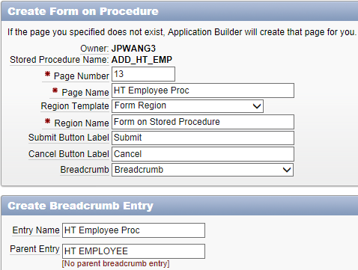
Form for Creating Employee
Creating a form on a procedure
Create page → Form → Form on a procedure
Procedure name: ADD_HT_EMP
Page name: HT Employee Proc
Breadcrumb: Breadcrumb
Breadcrumb parent entry: HT Employee report

Slide 5
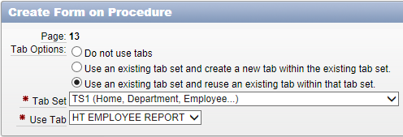
Form for Creating Employee
Tab options
Use an existing tab set and reuse an existing tab within that tab set
Tab set: TS1 (Home, Department, Employee…)
Tab label: HT Employee report

Slide 6
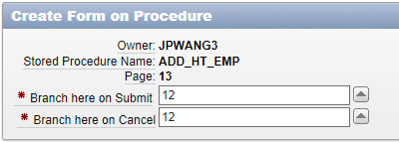
Form for Creating Employee
Invoking page: HT Employee (Report)
Button label: Add New Employee
Button region: Report
Button position: Bottom of region
Branching on submit and cancel: HT Employee (Report)

Slide 7
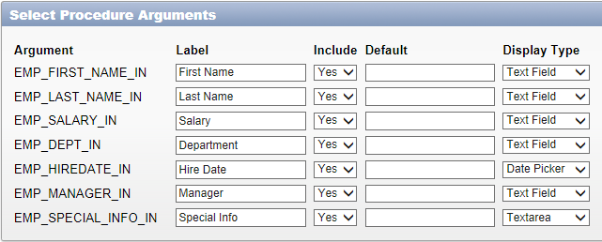
Form for Creating Employee
Select procedure arguments
Include all arguments
Modify labels accordingly
Select display type accordingly

Slide 8
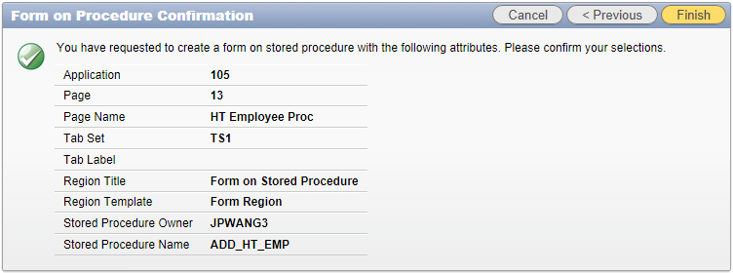
Form for Creating Employee
Confirmation and finish

Slide 9
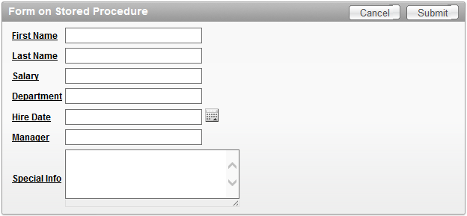
Form for Creating Employee
Further customization
Need to label required fields
Need validations for required fields
Need to create LOV for department and manager
Date format

Slide 10
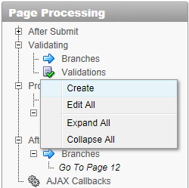
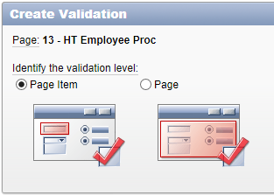
Form for Creating Employee
Create validation for required fields
Page processing → Validating → right click Validations → Create
Validation level: Page item
Identify the page item: first name (or last name)

Slide 11
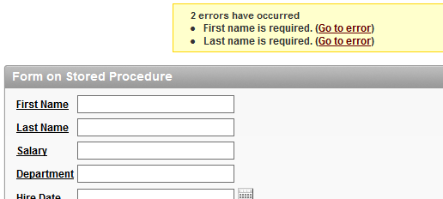
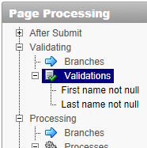
Form for Creating Employee
Create validation for required fields
Name: first name not null
Error display location: Inline in notification
Validation type: Not null
Error message: First name is required.
Then → Create

Slide 12
Form for Updating Employee
Creating a form on a procedure for updating employee
Create page → Form → Form on a procedure
Procedure name: UPD_HT_EMP
Page name: HT Employee Proc Update
Breadcrumb parent entry: HT Employee (Report)
Tab options
Use an existing tab set and reuse an existing tab within that tab set
Tab set: TS1
Use tab: HT Employee report

Slide 13
Form for Updating Employee
Creating a form on a procedure for updating employee
Invoking page: {none}(will invoke from report page)
Button label: {none}(will invoke from report page)
Branching
On submit and cancel: HT Employee (Report)
Select procedure arguments
Modify labels accordingly
Select display type accordingly
Keep the EMP_ID_IN

Slide 14
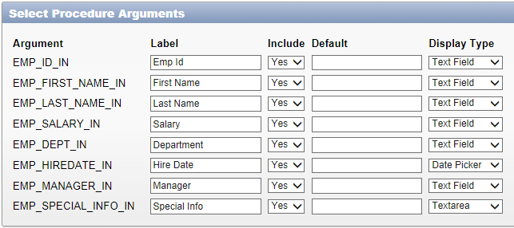
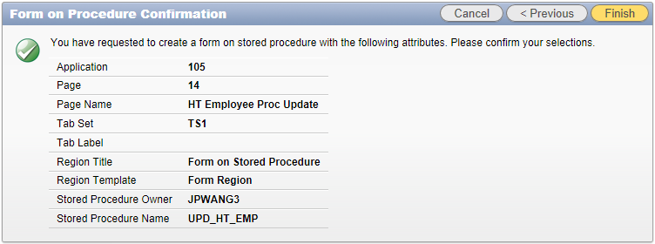
Form for Updating Employee

Slide 15
Form for Updating Employee
Edit or create the link on the report page to invoke the update form page
Edit the update form page for fetching record
Add a data manipulation process for page rendering
In Page rendering pane, under before header processes
Right click Processes → Create → Data manipulation → Automated row fetch
Name: fetch record
Table name: HT_EMP
Item containing PK column value: P??_P_ID_IN
Primary key column: EMP_ID

Slide 16
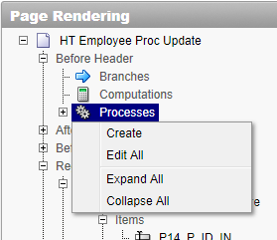
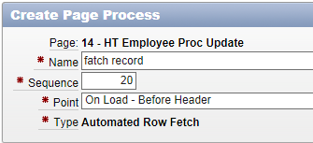
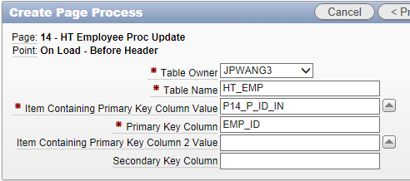
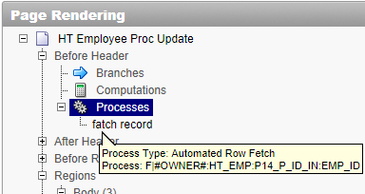
Form for Updating Employee

Slide 17
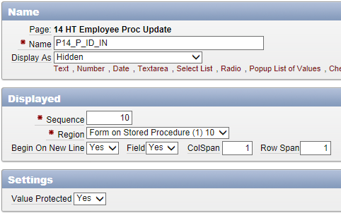
Form for Updating Employee
Employee ID needs be hidden and protected

Slide 18
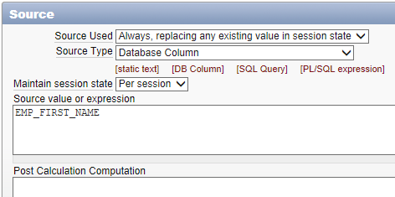
Form for Updating Employee
Edit each attribute item so item value can be fetched
Define database column
Edit item → Source section
Source used: Always, replacing any existing value in session sate
Source type: Database column
Source value or express: {table column name} (case sensitive)

Slide 19
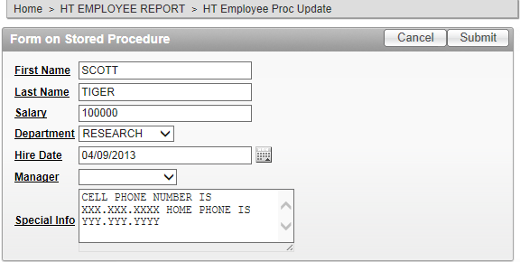
Form for Updating Employee

Slide 20
Form for Deleting Employee
Editing the form for deleting employee
Create a button for delete
Right click Region buttons → Create
Button name: DELETE
Label: Delete
Position: Region template position #DELETE#
Action: Submit page
(Optional) condition: Value of item / column in expression 1 is not null
Expression 1: P??_P_ID_IN

Slide 21
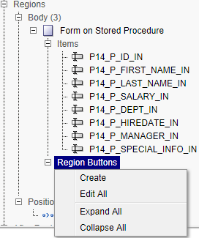
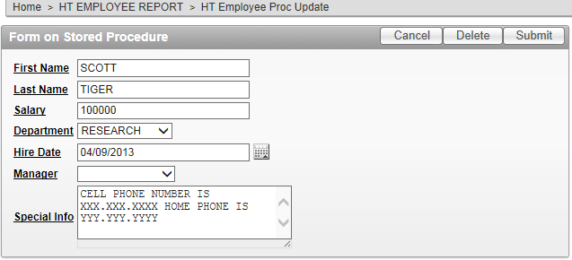
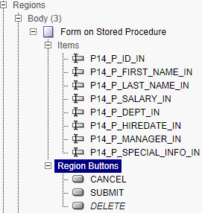
Form for Deleting Employee

Slide 22
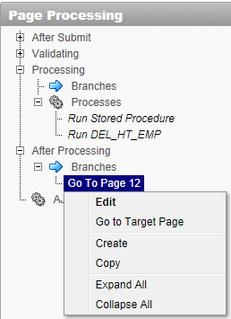
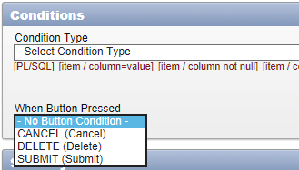
Form for Deleting Employee
Update branching action:
Right click the branch Go to page ??
Conditions section
When button pressed: No button condition

Slide 23
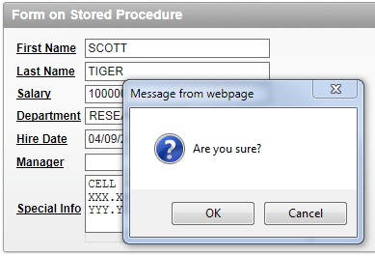
Form for Deleting Employee
Add delete confirmation:
javascript:confirmDelete('Are you sure?','DELETE');
Notes:
javascript:confirmDelete('Are you sure?','DELETE');

Slide 24
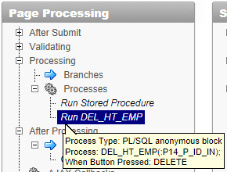
Form for Deleting Employee
Create a process for delete
Under page processing pane
Right click Processes → Create → PL/SQL
Name: Run DEL_HT_EMP
PL/SQL page process: DEL_HT_EMP(:P??_P_ID_IN);
(Optional) Success and error messages
When button pressed: DELETE

